Slide 1
MOTIVATION
Dr.Kate Dandesh Kumar Associate Professor Modern Institute of Teacher Education Kohima, Nagaland-797001

Slide 2
Meaning of Motivation
Motivation can be defined as the processes that account for an individual’s intensity, direction, and persistence of effort toward attaining a goal.
The word “motivation” comes from the Latin word “movere”, which means to move.
“A motivation is an inner state that energies, activates , or moves and that directs behavior towards goals.”
“A motive is restlessness , a lack , a yen, a force. One in the grip of a motive, the organism does something to reduce the restlessness, to remedy the lack , to alleviate the yen , to mitigate the force.”
“ Motivation is the complex forces starting and keeping a person at work in an organization. Motivation is something that moves the person to action and continues him in the course of action already initiated.”
“ Motivation refers to the way in which urges, drivers, desires, aspiration, striving or needs direct, control or explain the behavior of human beings .”

Slide 3
Definitions of Motivation
According to B.F. Skinner, “Motivation in school learning involves arousing, persisting, sustaining and directing desirable behavior.”
J P Guilford(1950) – “A motive is any particular internal factor of condition that tends to initiate and sustain activity”.
According to Woodworth, “Motivation is the state of the individual which disposes him to certain behavior for seeking goal.”
C W Good(1973)- “Motivation is the process of arousing, sustaining, and regulating activity”

Slide 4
Characteristics of Motivation
Motivation arousing interest in learning.
Motivation is sustaining interest in learning.
Motivation is directing behaviour.
Motivation initiates and energies activity in learning.
Motivation leads to self-actualization in learning.
Motivation arouses, sustains and directs behaviour.
Motivation stimulates learning activity.
Motivation is the arousal of tendency to act and produce result.
Motivation is directed to a selective goal.
Motivation provides the energy and accelerates the behaviour of the learner.

Slide 5
Terminology of Motivation
Motive
Drive
Incentive
Interest
Curiosity
Goal
Arouser
Expectancy

Slide 6
Types of Motivation
Intrinsic Motivation:
Intrinsic motivation means that the individual's motivational stimuli are coming from within. The individual has the desire to perform a specific task, because its results are in accordance with his belief system or fulfills a desire and therefore importance is attached to it.
Some Examples:
Acceptance: We all need to feel that we, as well as our decisions, are accepted by our co-workers.
Curiosity: We all have the desire to be in the know.
Honor: We all need to respect the rules and to be ethical.
Independence: We all need to feel we are unique.
Order: We all need to be organized.
Power: We all have the desire to be able to have influence.
Social contact: We all need to have some social interactions.
Social Status: We all have the desire to feel important.

Slide 7
2. Extrinsic Motivation:
Extrinsic motivation means that the individual's motivational stimuli are coming from outside. In other words, our desires to perform a task are controlled by an outside source. Note that even though the stimuli are coming from outside, the result of performing the task will still be rewarding for the individual performing the task.
Some Examples:
Employee of the month award
Benefit package
Bonuses
Organized activities

Slide 8
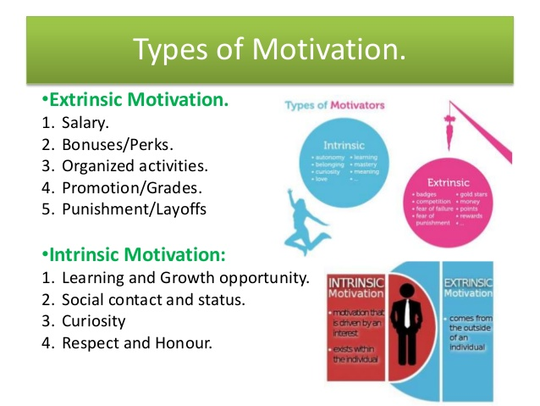

Slide 9
Sources of Motivation
Curiosity
Interest
Goal Setting
Motive Matching
Environment
Necessity
Fear
Revenge
Vanity
Mastery

Slide 10
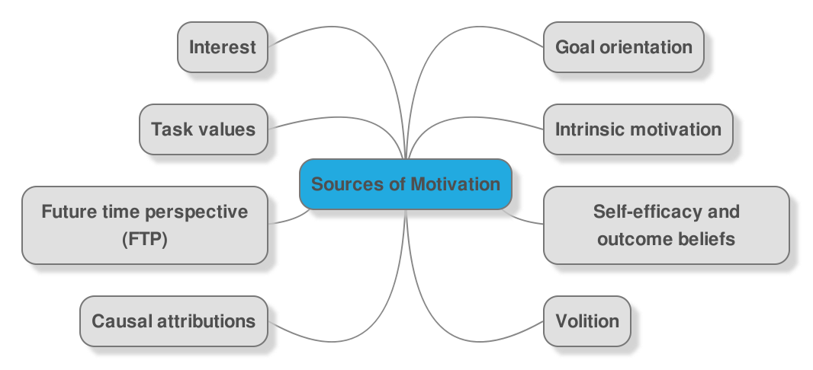
Sources of Motivation

Slide 11
Maslow’s Theory of Motivation
Abraham Maslow was a foremost Psychologist. He developed a theory (Human Needs) in which he identified five vital human needs in motivation.
These needs according to the Maslow are:
1. Physiological Needs
2. Safety Needs
3. Love and Belongingness Needs
4. Self-Esteem Needs
5. Self-Actualization Needs

Slide 12
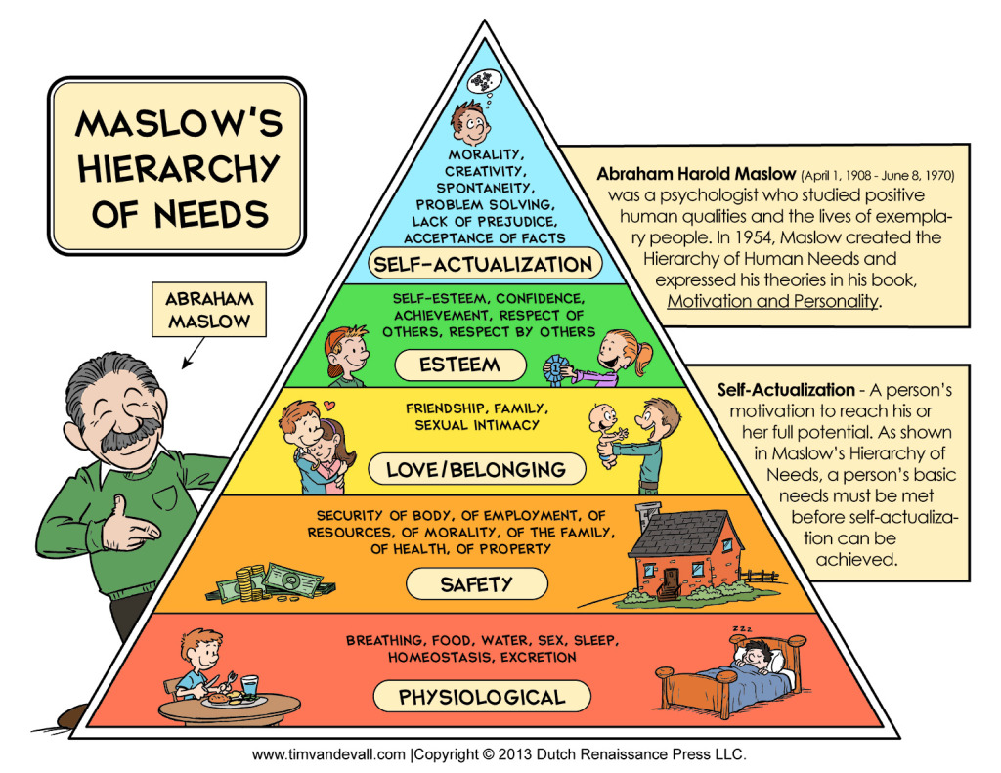
Maslow’s Hierarchy Theory of Motivation

Slide 13
Lower Order Needs:
1. Physiological Needs: These are the biological or survival needs of man. They are the most basic needs that control the other needs. Until these needs are fulfilled or satisfied, man will not be able to go to the next level.
Examples of these needs are the desire to eat food when hungry, drink water when thirsty or the need for rest, sex, air or to excrete unwanted materials from the body systems.
2. Safety Needs: Human beings require safety and protection from danger or external aggressors. After one has successfully dealt with physiological needs, it is desirable to cater for psychological needs.
At this point, Man will be thinking of where to live and efforts will be made to keep him/herself from impending dangers, threats or hazards.

Slide 14
Higher Order Needs:
3. Love and Belongingness Needs: This involves the aspiration of man to establish a cordial relationship with others. It is the need of man to love and be loved. At this level of need, people will like to extend their hands of fellowship or comradeship to their friends, mates, co-workers or neighbours.
4. Self-Esteem Needs: These are the things we desire in order that our ego will be boosted. After the individual has been accorded respect or recognition by others, the next thing for him/her is to start seeking for the things that will make him/her enjoy considerable influence from others. The ability of someone to fulfil this condition makes him/her feel superior and self-confident. Inability to fulfil this need, makes a person feel dejected or inferior.
5. Self-Actualization Needs: When a person has successfully achieved or gained the most basic needs or wants, then such an individual will want to get a rare opportunity. It is the time when a person will like to distinguish him/herself, by seeking for power or extra-ordinary achievement. At this point person is said to have reached the peak of his potentials.

Slide 15
Classroom Implications of Theory of Motivation
• It is important for the teacher to know the basic needs of his/her students and cater for these according to level of their important. For example, the teacher needs to think first of students’ food, rest or health before thinking of teaching them.
• When the teacher praises his/her students for doing well in their study or assignment, they will be spurred to sustain that effort.
• A classroom, which is well decorated or adorned with beautiful charts, and learning materials will be students’ friendly. The students’ minds will always be attracted to the activities in a beautifully adorned classroom.
• In the classroom, students like being recognized or respected. When their views are recognized or respected, they will have their confidence boosted and developed.

Slide 16
. From the beginning of the lesson, the teacher should endeavour to make his/her students know possible outcome of the lesson. It is when the students know what they are likely to achieve from the lesson that their attention will be arrested and sustained.
• Feedback is necessary if the interest of the students must be sustained in the classroom. So the teacher should always strive to let them know how they are performing in the teaching learning activities.
• The teacher should also provide/plan for extra-curricular activities for his/her students. When the teacher does this, the students will have opportunity of establishing a genuine interaction among them. Besides, they will be able to display their hidden talents.
• When dealing with the students in the classroom, the teacher should take into consideration, the developmental changes and differences in the students before deciding on the particular motivation pattern to be employed.

Slide 17
Techniques of Enhancing Learner Motivation
Attractive Physical and Environmental Conditions
Sublimation of Innate Impulses
Stimulus Variation and the Teacher
Reinforcement (Praise and Blame)
Extrinsic Learning Rewards and Punishment
Attainable Goal
Experience of Success
Competition and Cooperation
Knowledge of Progress
Novelty
Teaching Skills

Slide 18
References
IGNOU (2016), Childhood and Growing Up (BES-121), New Delhi.
J.C Aggarwal (2015), Essentials of Educational Psychology, Vikas Publishing House, Noida.
Girish Pachori (2007), Psychological Foundation of Education, Surya Publication, Meerut.
S.K.Mangal (2011), Advanced Educational Psychology, PHI Learning, New Delhi.

Slide 19
THANK YOU

